Slide 1




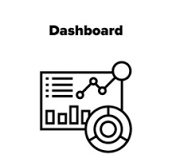


ARCHITECTURE DIAGRAM
Extract(csv)
Transform(Power Query Editor)
Load (Data)
Cross Verification(SQL,XL)
Visualization
Report ,Data driven Results
To Customer

